Slide 1
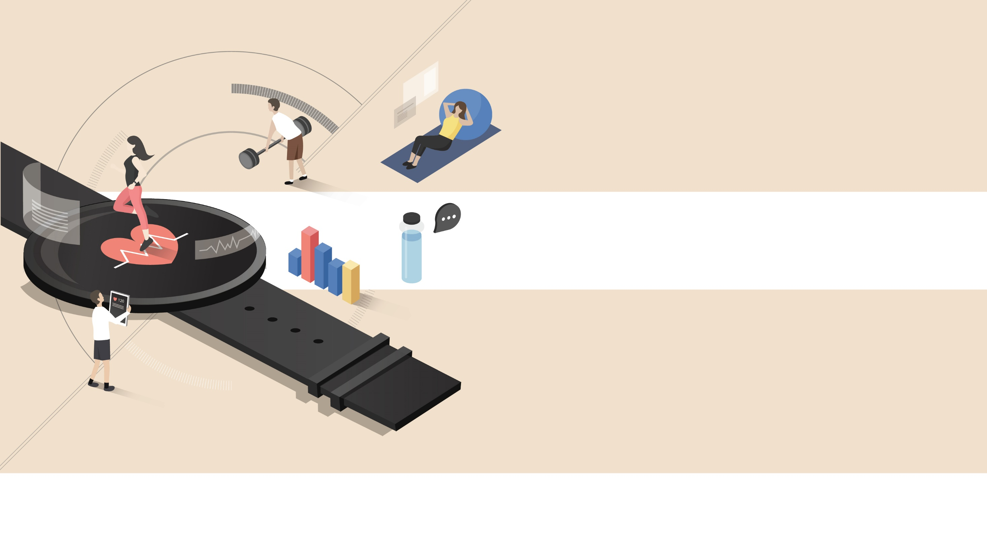

Mobile System Engineering, Dankook University
Basic Mobile Lab II

Slide 2
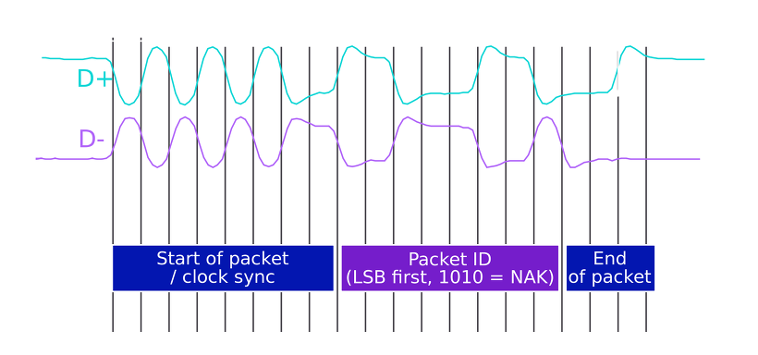
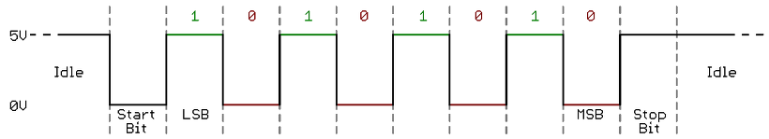
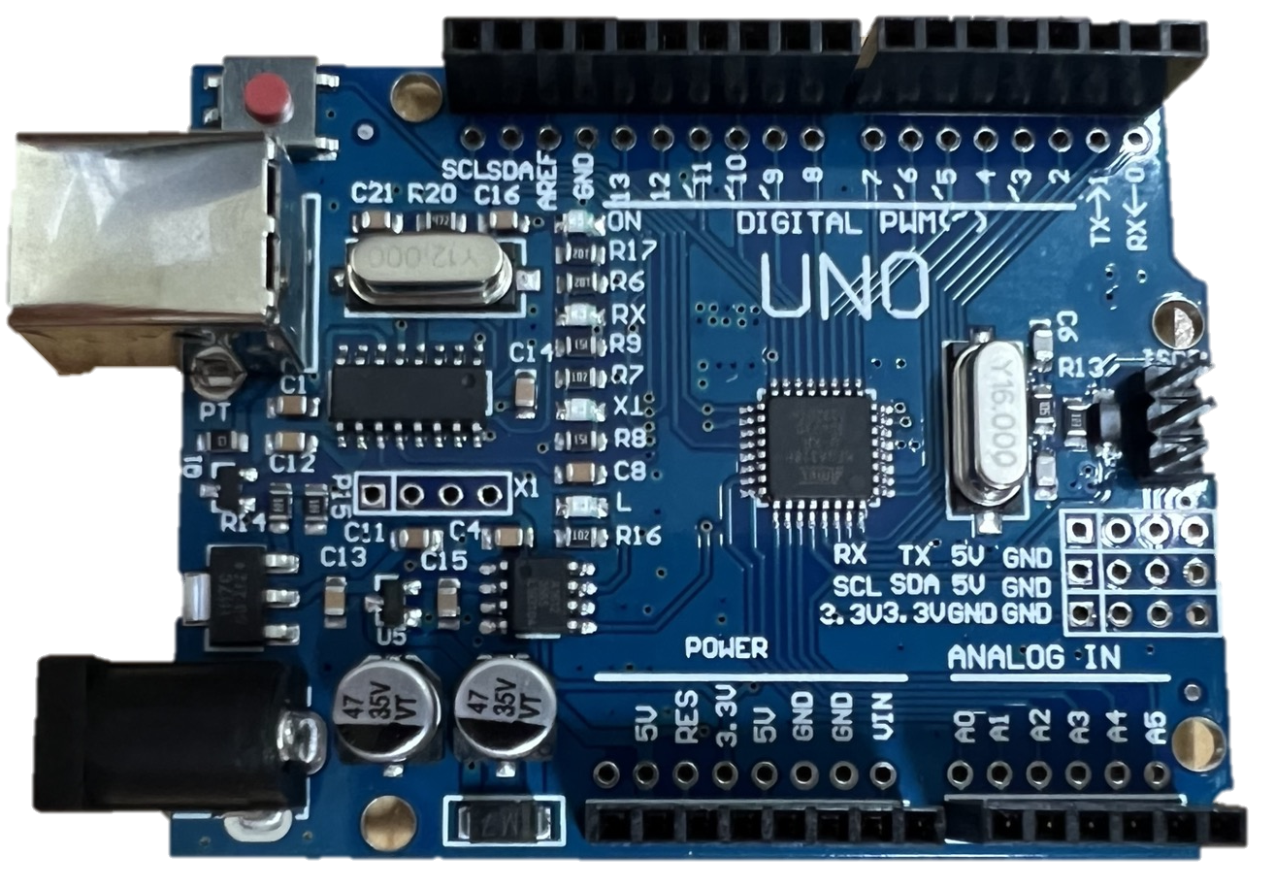
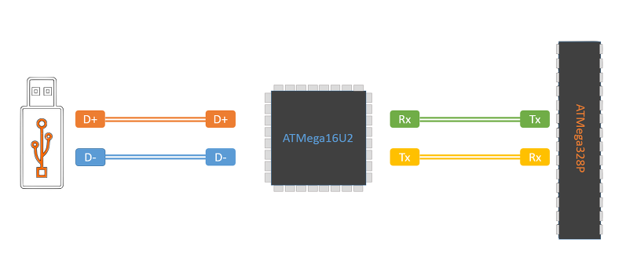
1
USB Bridge – ATmega16u2 / CH340
USB to Serial Converter
Usb data converts to serial communication data
USB
Serial
CH340
Notes:
아두이노 우노 - USB to Serial 통신 (tistory.com)

Slide 3
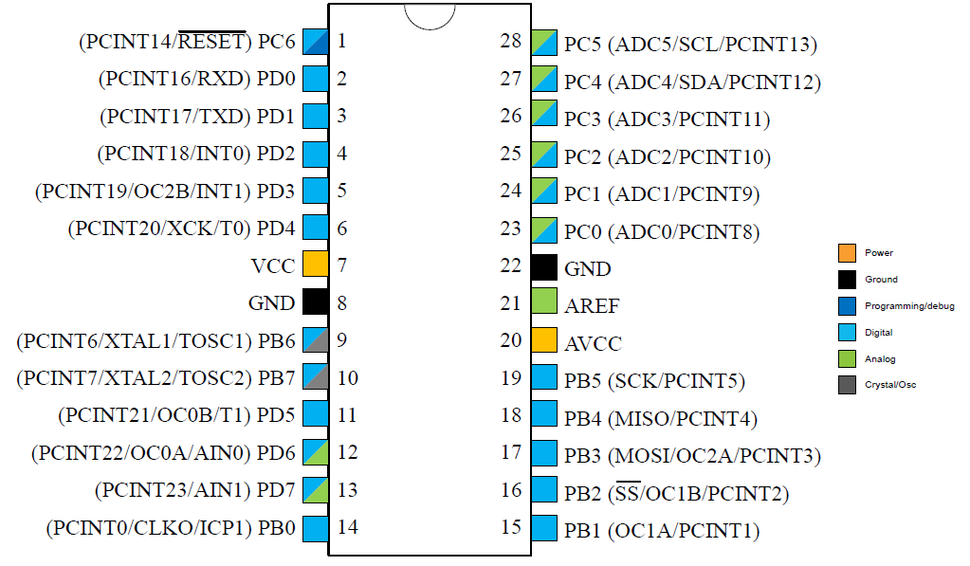
2
Microcontroller – ATmega328(28 pin DIP(Dual In-Line))
ATMEGA328-PU Datasheet(PDF) - ATMEL Corporation (alldatasheet.com)

Slide 4
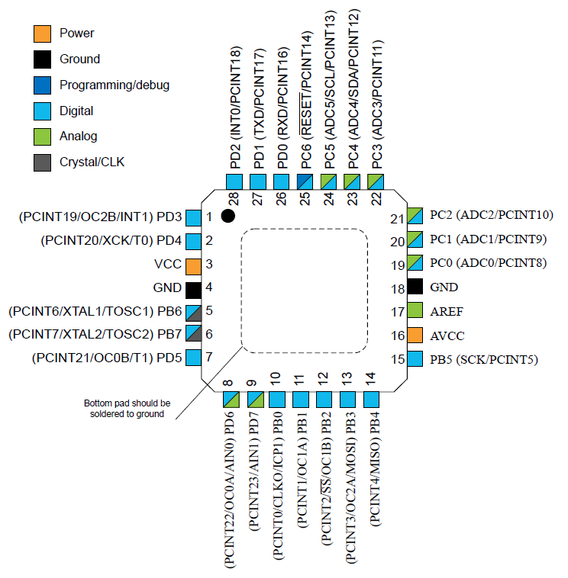
3
Microcontroller – ATmega328(28 pin MLF(Micro LeadFrame))
Features
High performance, Low power AVR® 8-Bit Microcontroller
Advanced RICS Architecture
High Endurance Non-volatile Memory Segments
32K Bytes of In-system self-programmable Flash program memory
1K Bytes EEPROM
2K Bytes Internal SRAM
Peripheral Features
6 PWM channels
6-channel 10-bit ADC
Programmable Serial UART
Master/Slave SPI Serial Interface
Byte-oriented 2-wire Serial Interface(I2C)
I/O and Packages
23 Programmable I/O Lines
Operating Voltage
1.8V~5.5V for ATmega328P
Temperature Range: -40°C to 85°C

Slide 5
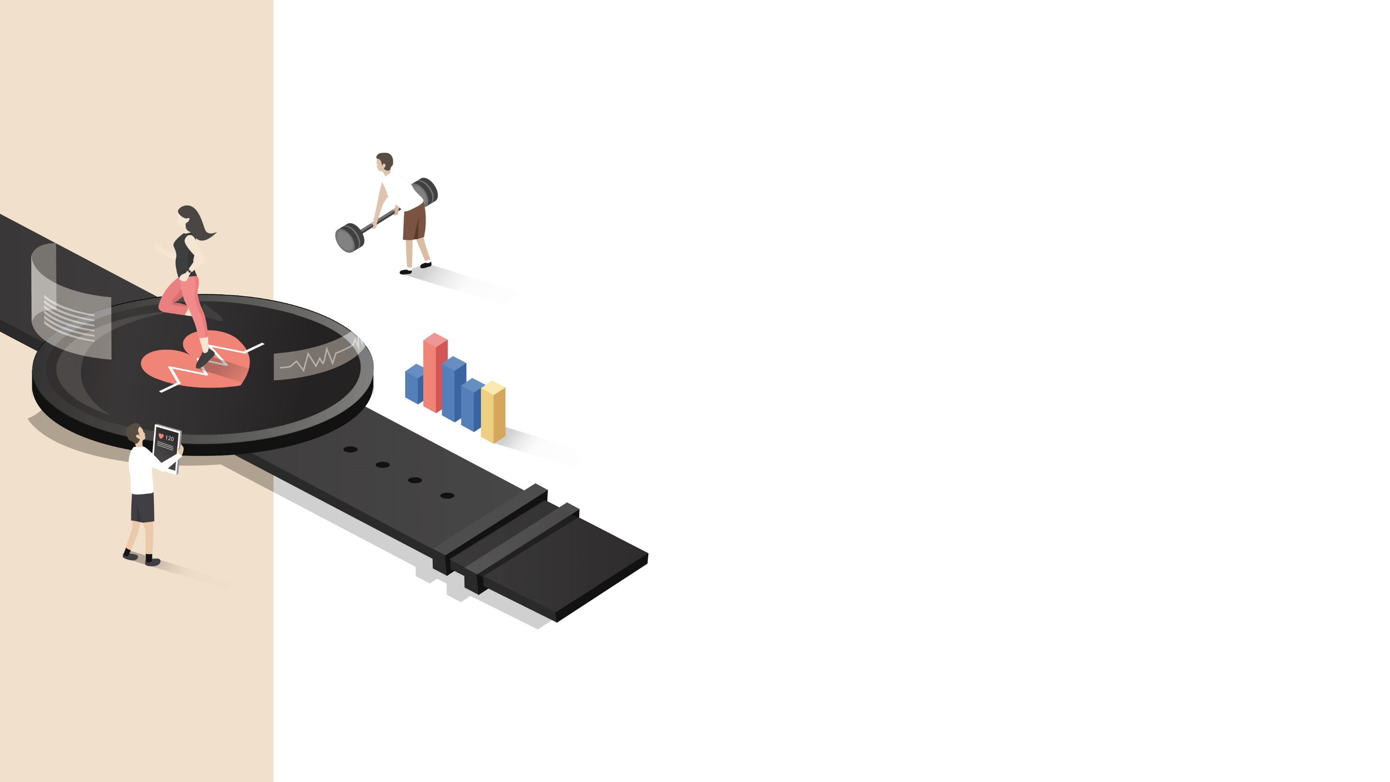
Arduino Communication method
2

Slide 6
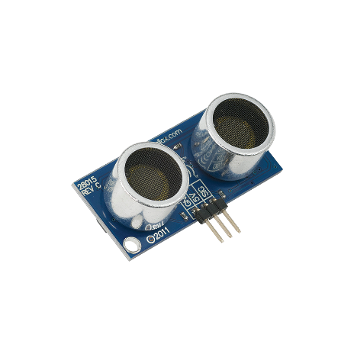
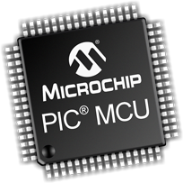
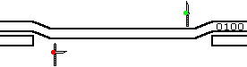
1
Arduino Communication method
Classification according to data transmission method
Simplex
Half Duplex
Full Duplex

Slide 7
2
Arduino Communication method
Serial Interface
1). Synchronous Serial
Data is sent in a continuous stream at constant rate. The clocks in the transmitting and receiving devices are synchronized. No start or stop bits are required.
OUT
CLK
IN
CLK
b0
b1
b2
b3
b4
b5
b6
b7
Pros: fast communication
Cons: master and slave structure
2). Asynchronous Serial
Instead of a common synchronization signal, the data stream contains synchronization information in form of start and stop signals, before and after each unit of transmission, respectively.
OUT
IN
b0
b1
b2
b3
b4
b5
b6
b7
b8
b9
Start
Pros: fewer lines required for communication
Cons: slow communication(require start and end signals to indicate)
End
Notes:
시리얼 통신 기초 (Serial Communication) | Hard Copy World

Slide 8
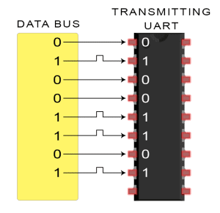
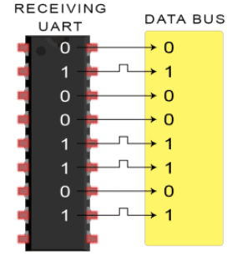
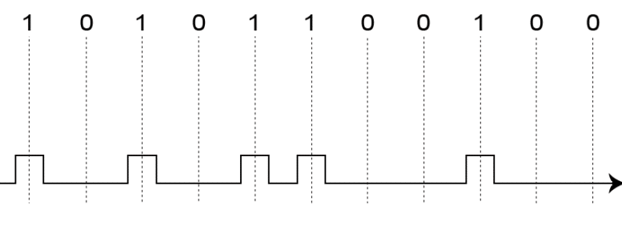
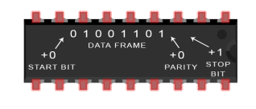
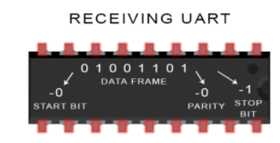
3
Arduino Communication method
1. Serial(UART, Universal Asyncronous Receiver/Transmitter)
Asyncronous
It communicates by converting data, processed at once in parallel into a data stream serially
1(High) -> 3.3V, 0(Low) -> 0~0.8V
Simple method, low cost, easy to implement, but low speed and throughout.
Arduino serial communication pin(UNO): D0(RX-Receive), D1(TX-Transmit)

Slide 9
4
Arduino Communication method
1. Serial(UART, Universal Asyncronous Receiver/Transmitter)
Baudrate: data rate transmitted over serial line.
- Unit[bps] -> bit per second
- EX) 9600[bps] -> 9600bits per 1 second
Frame of the data
- data packet
Frame:
Start
Data
Parity
Stop
Size(bits):
1
5-9
0 or 1
1-2
Notes:
시리얼 통신 기초 (Serial Communication) | Hard Copy World

Slide 10
5
Arduino Communication method
1. Serial(UART, Universal Asyncronous Receiver/Transmitter)
Frame of the data
- Parity bit(Check bit): A bit added to a string if binary code. Simple form of error detecting code. It ensures that the total number of 1-bits in the string is even or odd. Optional bit.
Transmit 120 in 8bit
Receive 56 in 8bit
0
1
1
1
1
0
0
0
0
?
1
1
1
0
0
0
ERROR – Wrong data
* Apply even parity
Can predict the total number of 1bits was an even number
Total number of 1 bits -> 4 -> even
1
1
1
1
0
0
0
0
?
1
1
1
0
0
0
0
Receive 120 in 8bit
1
1
1
1
0
0
0
0
Notes:
코끼리를 냉장고에 넣는 방법 :: [개념정리] 패리티 비트(Parity Bit)란? (tistory.com)

Slide 11
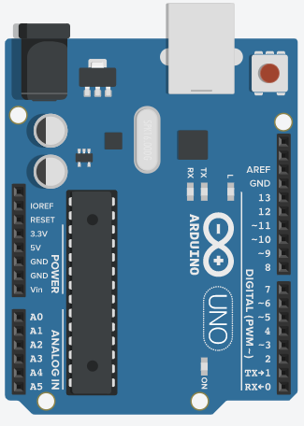
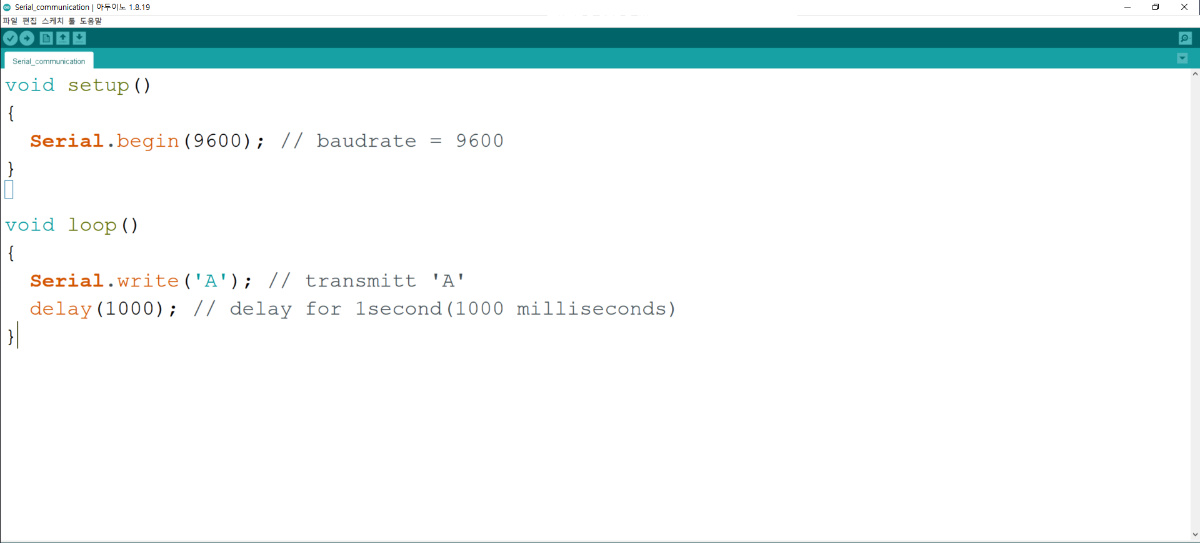
6
UART Experiment
GND -> Probe GND
TX -> Probe hook

Slide 12
7
UART Experiment
Text -> ASCII -> Binary
ASCII, 10진수, 16진수, 8진수, 2진수 변환표 - IBM Documentation

Slide 13
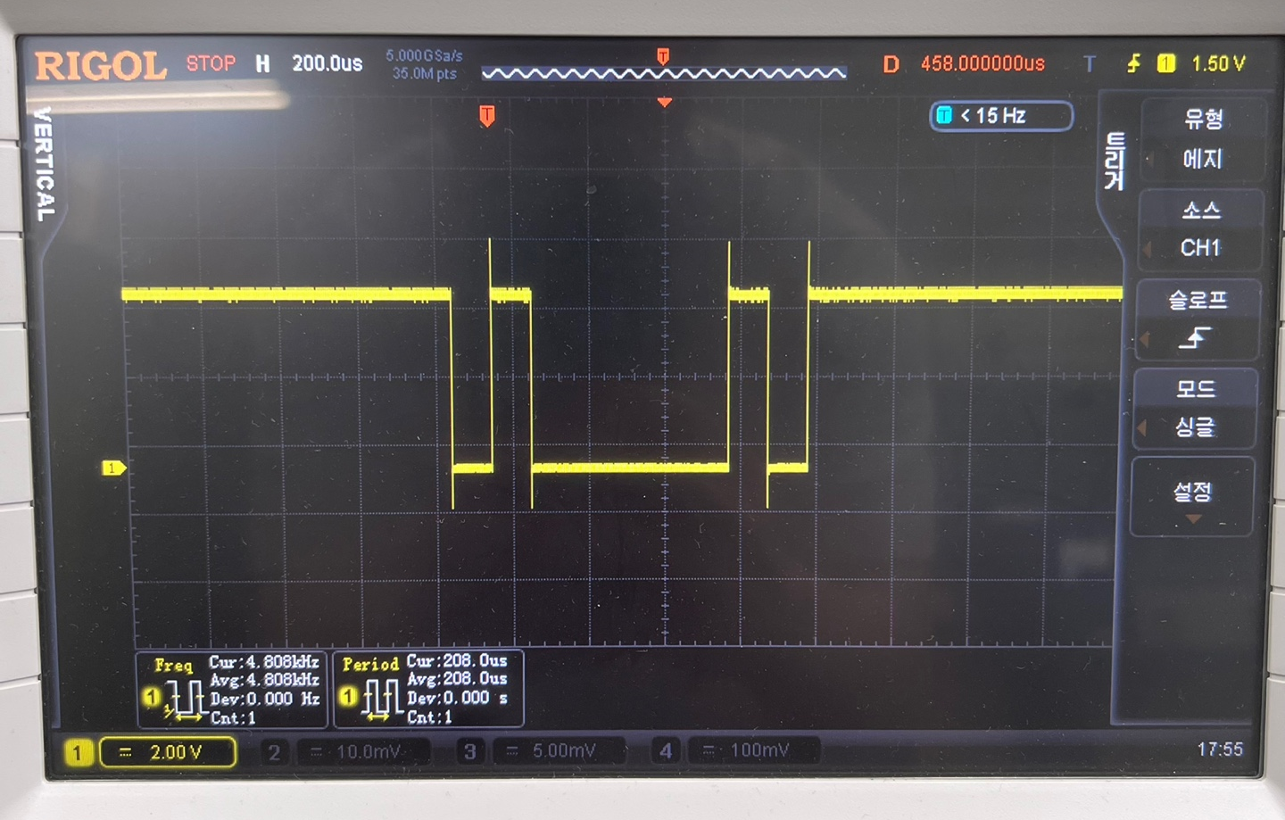
8
UART Experiment
0100000101
End signal
Start signal
Text -> ASCII decimal-> Binary
A -> 65 ->1000001

Slide 14
9
Arduino Communication method
2. SPI(Serial Peripheral Interface)
Synchronous
A protocol for multiple slave devices to commiunicate with one master devices. -> 1:N
Use 4 lines for communication
Full duplex (Clock: SCL)
SLAVE 1
SLAVE n
SCK
MOSI
MISO
SS
SCK
MOSI
MISO
SS
 | description
SCK | Serial clock
MOSI | Master output / Slave input
MISO | Master input / Slave output
SS | Slave select
MASTER
SCK
MOSI
MISO
SS1
SSn

Slide 15
10
Arduino Communication method
2. SPI(Serial Peripheral Interface)
Master to Slave
Slave to Master
SCK
0
1
2
3
4
5
6
7
0
1
2
3
4
5
6
7
MOSI
ASCII ‘S’
1
1
0
0
1
0
1
0
MISO
ASCII ‘F’
0
1
1
0
0
0
1
0
SS
End after last byte sent or received

Slide 16
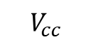
11
Arduino Communication method
3. I2C(Inter-Integrated Circuit) or TWI(Two Wire Interface)
Synchronous
A protocol for multiple slave devices to commiunicate with multiple master devices. -> N:N
Use 2 lines for communication
Half duplex (Clock: SCL)
$$V_{cc}$$
Device1
(Master)
Device2
(Slave)
Device3
(Slave)
Device N
(Slave)
R1
R2
…
Pull-up resistor
SDA
SCL

Slide 17
12
Arduino Communication method
3. I2C(Inter-Integrated Circuit) or TWI(Two Wire Interface)
Frame of the data
Slave Address: To indicate which salve the data transmitted by the master goes to.
Data: data to transmit.
Write(0) – master is sending data
Read(1) – mater is requesting data
Write bit
ACK(0)/NACK(1): ‘1’ indicates that the addressed slave did not respond or was unable to process the request. This bit controls by slave device.
Ack bit
Ack bit
7 addreses bits
8 data bits
SDA
Slave Address
Data (Master)
SCL
…
…
start
1
2
7
8
9
1
2
8
9
stop
SDA goes low before SCL
Example of write data to slave device
SDA goes high after SCL

Slide 18
13
Arduino Communication method
 | UART | I2C | SPI
Type | Asynchronous | synchronous | synchronous
Topology | 1:1 | N:N | 1:N
Signal lines | Rx, Tx | SDA, SCL | SCK, MISO, MOSI, SS
Duplex | Full | Half | Full
Speed | slow -> fast |  | fast

Slide 19
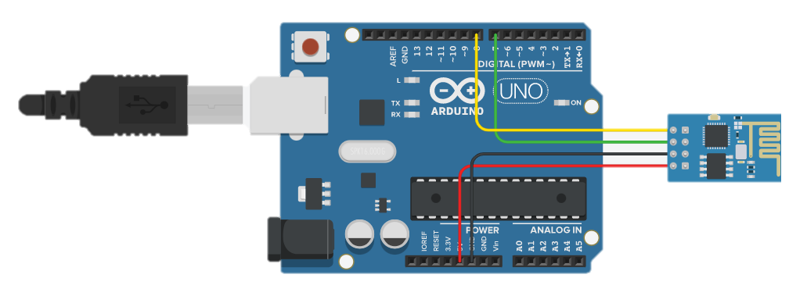
14
Arduino Communication method
4. Software serial
If D0 and D1 pins are already being used for communication, you can use the other digital pins to use the software serial library.
11
10
RXD
TXD
GND
VCC
5V
GND
10 pin -> RXD 11 pin -> TXD GND -> GND 5V -> VCC

Slide 20
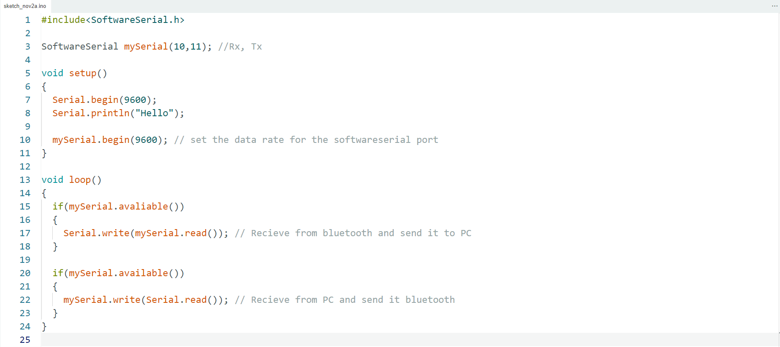
15
Arduino Communication method
4. Software serial
If D0 and D1 pins are already being used for communication, you can use the other digital pins to use the software serial library.

Slide 21




1
Bluetooth

Slide 22
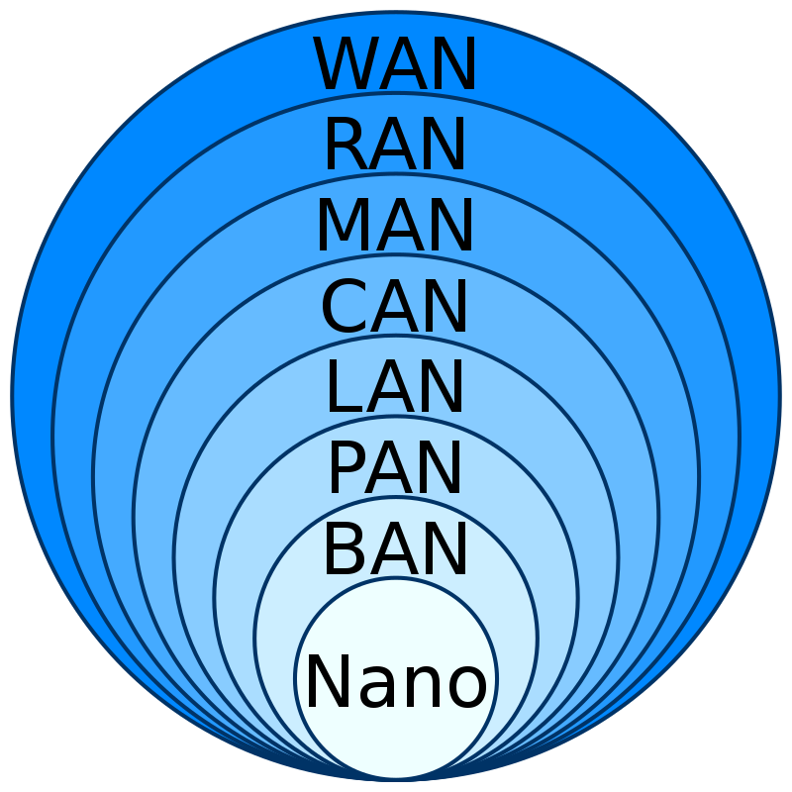
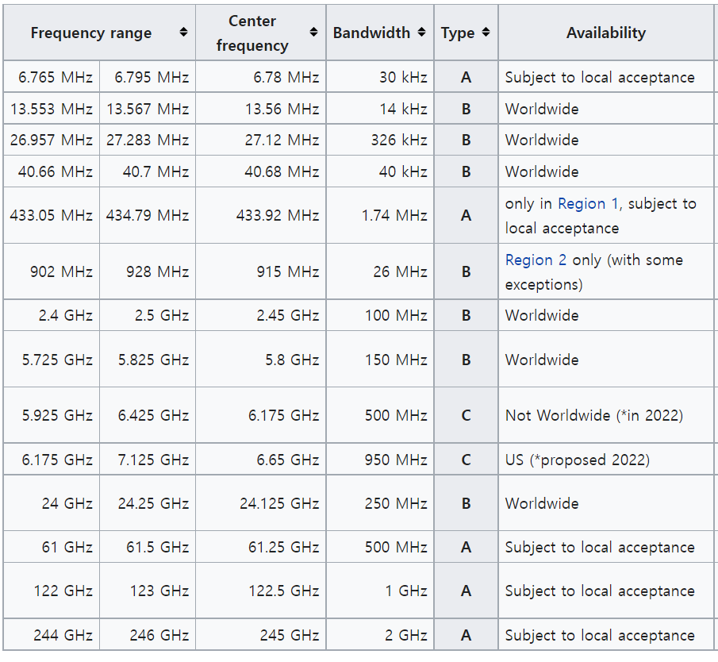
2
Bluetooth
Bluetooth
A short range wireless technology(~10[m])
use for exchanging data between fixed and mobile devices over short distance and building personal area networks(PAN).
It uses UHF(Ultra High Frequency) radio waves
in the ISM(Industry-Science-Medical) bands, from
2402~2480[MHz].
Master
Slave
Bluetooth
Zigbee
NFC(Near Field Communication)
Computer network types by spatial scope
Class | power[mW] | distance[m]
Class1 | 100 | 100
Class2 | 2.5 | 10
Class3 | 1 | 1
Class4 | 0.5
ISM bands
Bluetooth device power and distance by class
Notes:
Data Networks classification by spatial scope - 개인 통신망 - 위키백과, 우리 모두의 백과사전 (wikipedia.org)

Slide 23
3
Bluetooth
Pros
avoid interference from other wireless devices
low power consumption
cheap cost
can connect through any obstacles
Cons
low bandwitdth compare to Wi-fi
short range communication between devices
weak security

Slide 24
4
Bluetooth
Bluetooth principle
master, slave communication
M
S
M
M
M
M
S
S
S
S
S
S
S
S
Single Slave Piconet
Multi-Slave Piconet
Scatternet

Slide 25
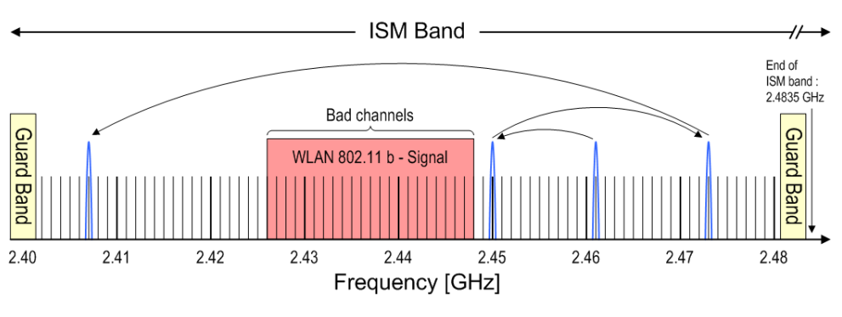
5
Bluetooth
Bluetooth principle
BT uses a frequency-hopping spread spectrum(FHSS) method to prevent interference between radio waves because it uses the same frequency in many devices.
The frequency of a BT radio is changed by frequency hops between ISM band channels.
79 channels, 1[MHz] bandwidth, maximum hop rate 1600[Hz](=625us)
$$f_{c}=2402\left[MHz\right]+k⋅1\left[MHz\right] ;k=0,1,…,78$$

Slide 26
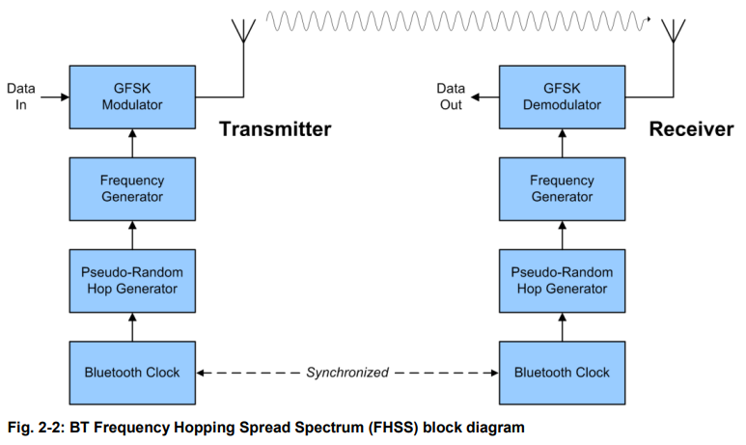
5
Bluetooth
Bluetooth principle

Slide 27
MIT APP INVENTOR

Slide 28
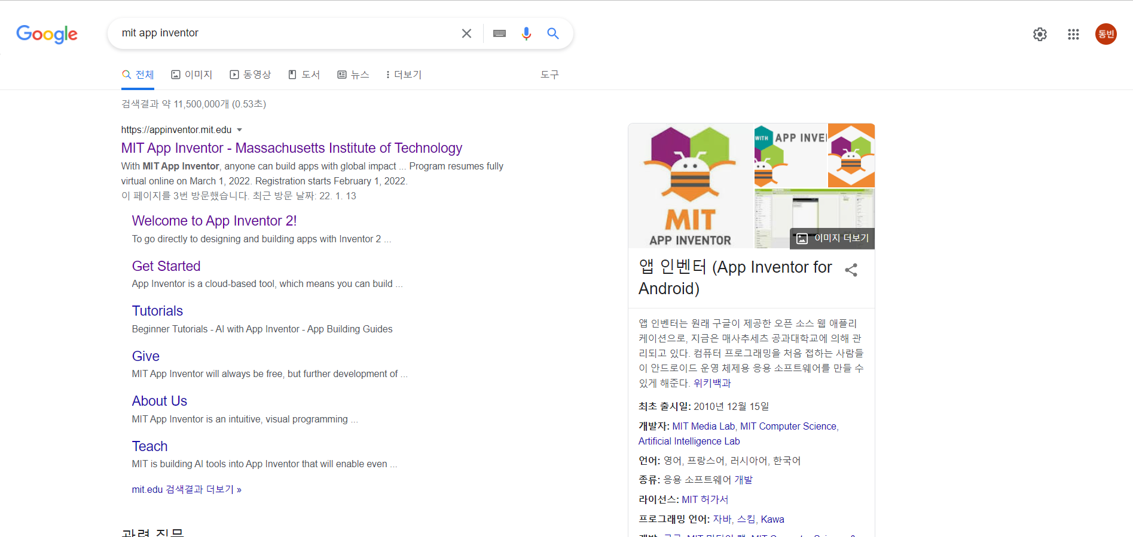
3
MIT APP INVENTOR
search MIT APP INVENTOR on Google
MIT APP INVENTOR select

Slide 29
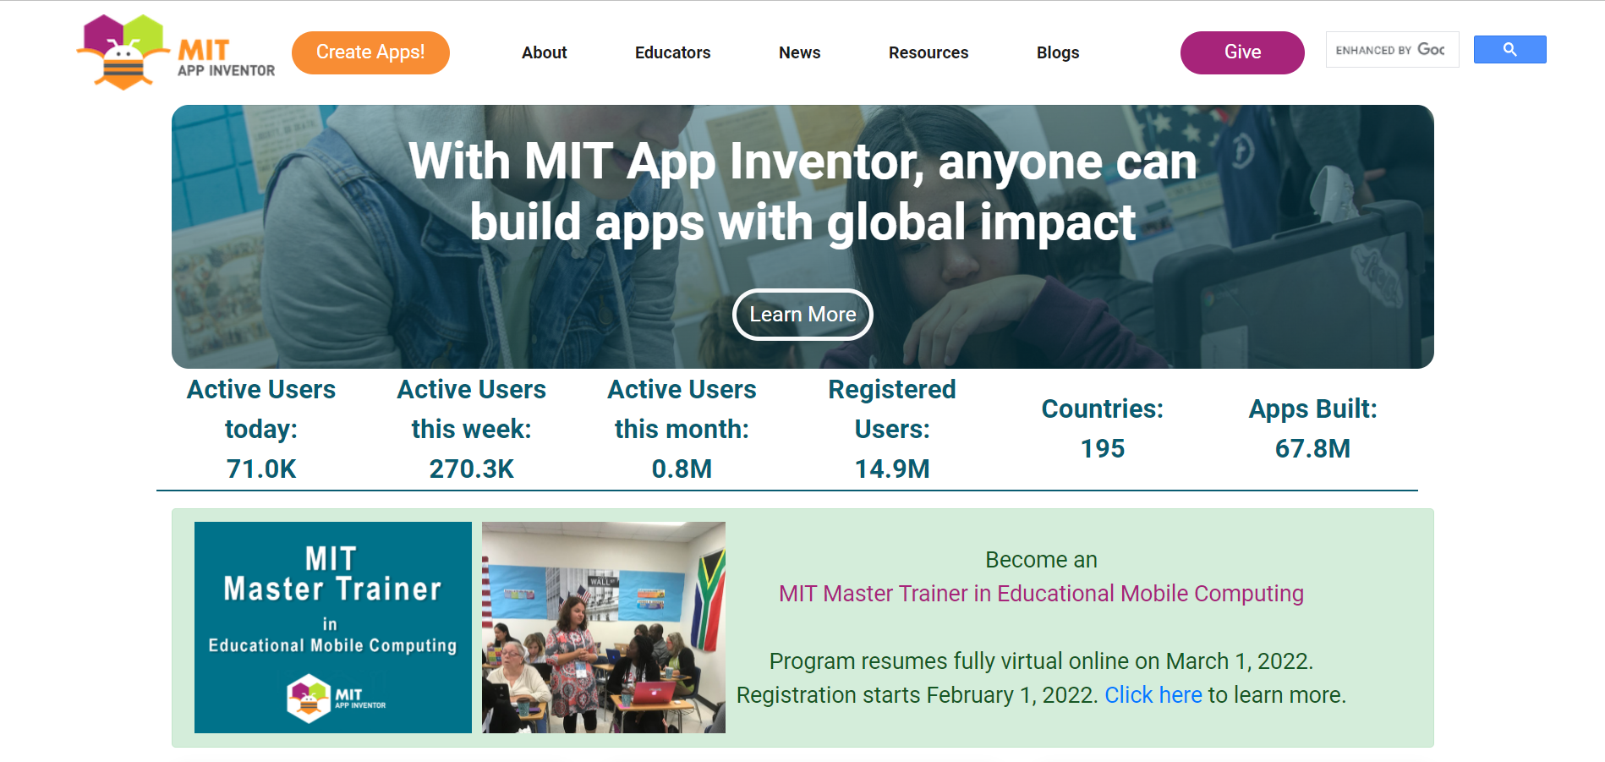
3
MIT APP INVENTOR
3. Create Apps! to create your account

Slide 30
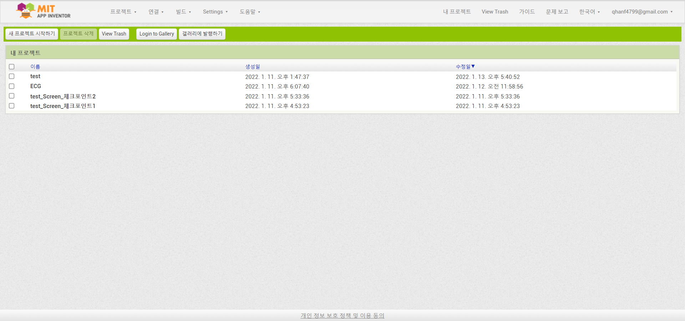
3
MIT APP INVENTOR
4. New project -> project name

Slide 31
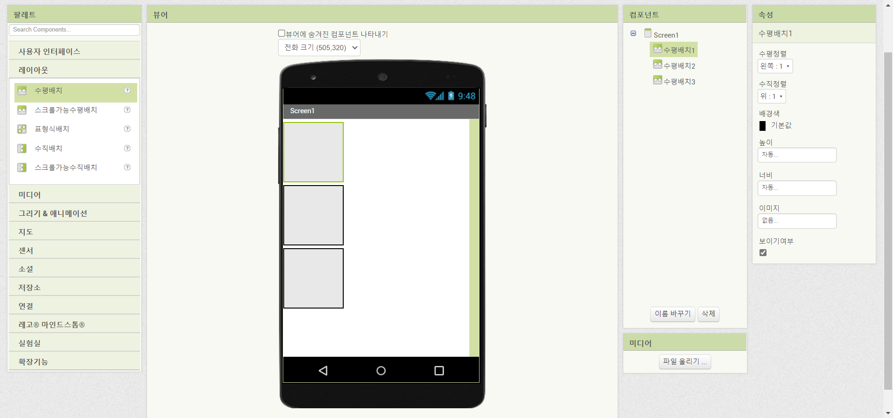
3
MIT APP INVENTOR
5. layout -> drag and drop 3 Horizontal Arrangement

Slide 32
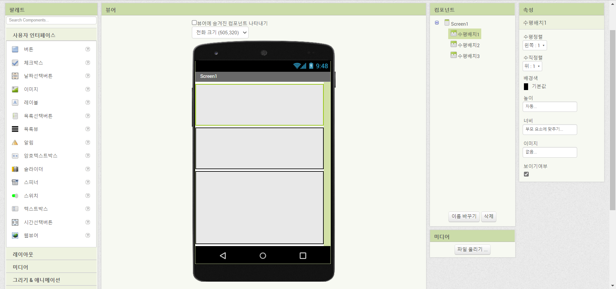
3
MIT APP INVENTOR
6. select Horizontal Arrangement 1,2 -> height: automatic, width: fill parents
7. select Horizontal Arrangement 3 -> height: fill parents, width: fill parents

Slide 33
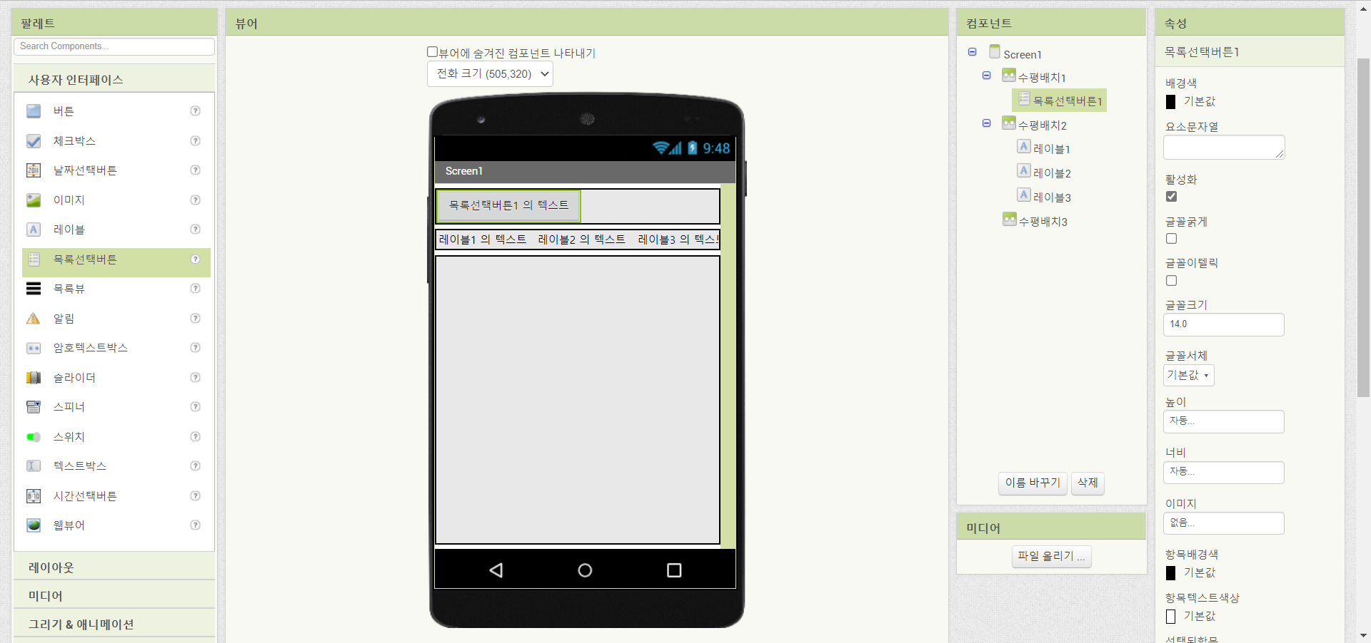
3
MIT APP INVENTOR
User interface
Horizontal Arrangement 1 -> add list picker , Horizontal Arrangement 2 -> add 3 labels

Slide 34
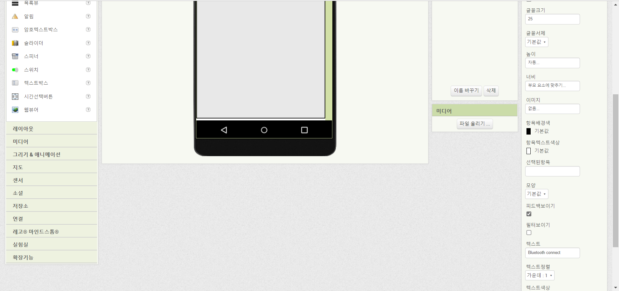
3
MIT APP INVENTOR
List picker 1
Font size -> 25, Width -> fill parent, Text -> Bluetooth connect

Slide 35
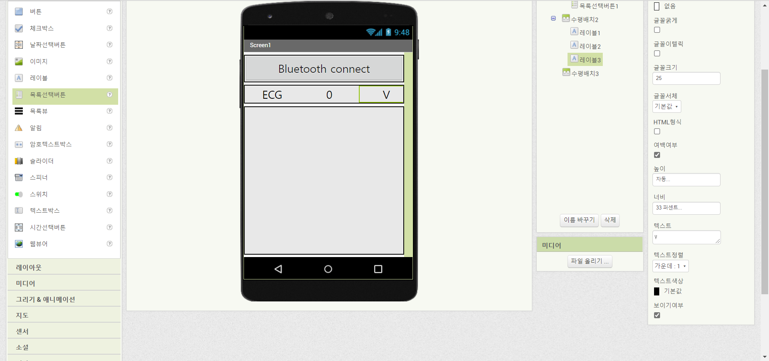
3
MIT APP INVENTOR
label 1,2,3
Font size -> 25, Width -> 33%, Text -> ECG, 0, V(label 1,2,3)

Slide 36
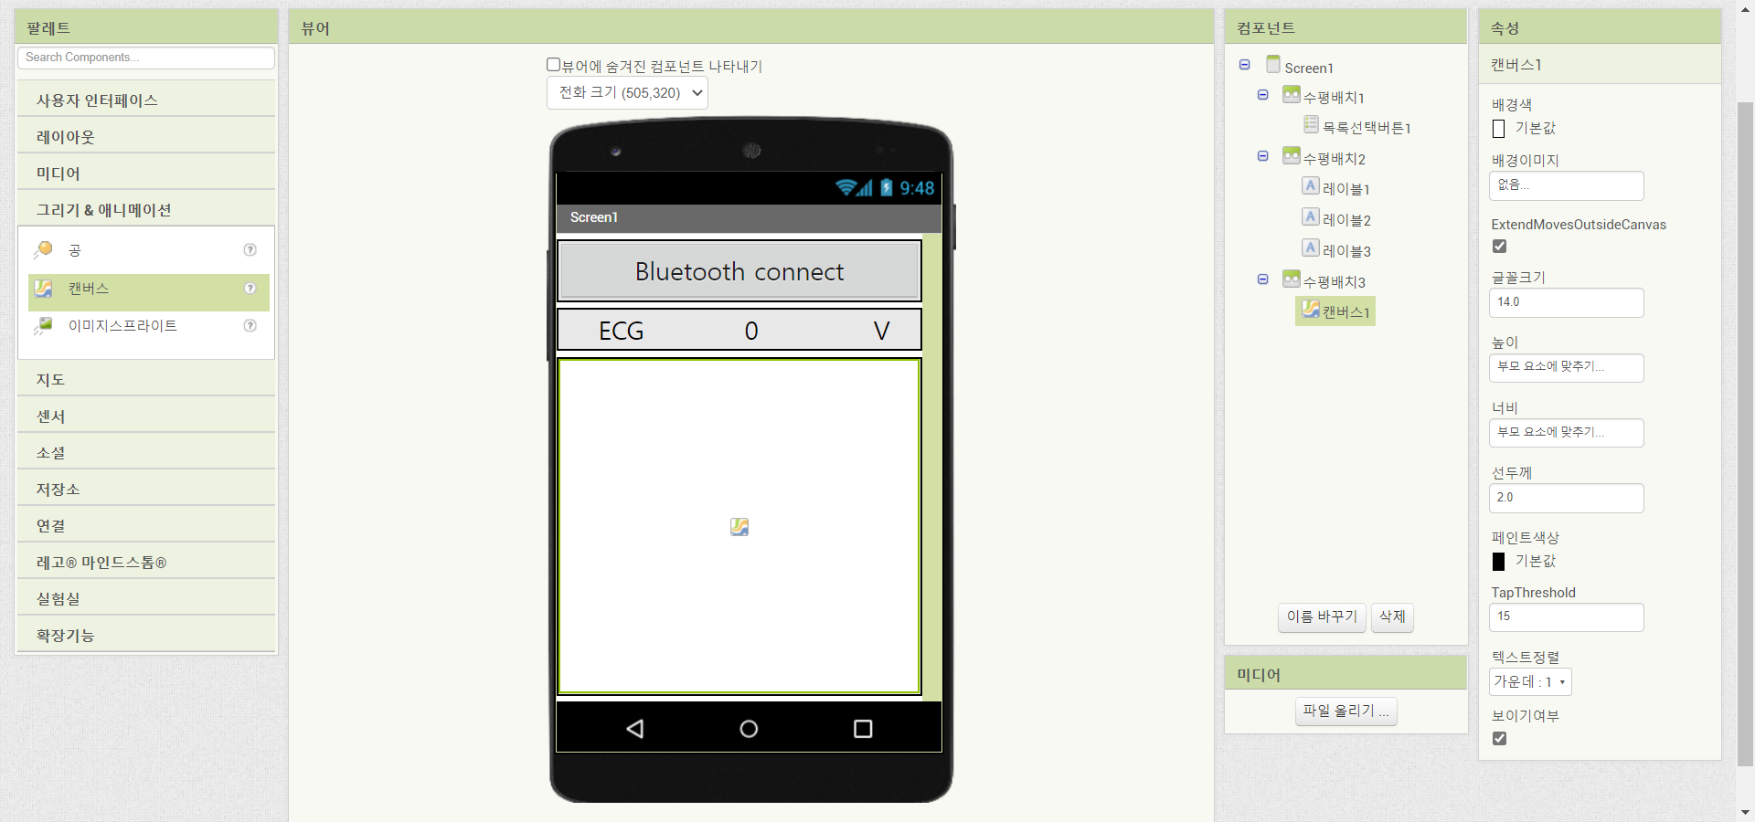
3
MIT APP INVENTOR
drawing & animation (canvas) -> add to horiziontal arrangement
Extend Moves Outside Canvas check, height & width -> fill parent

Slide 37
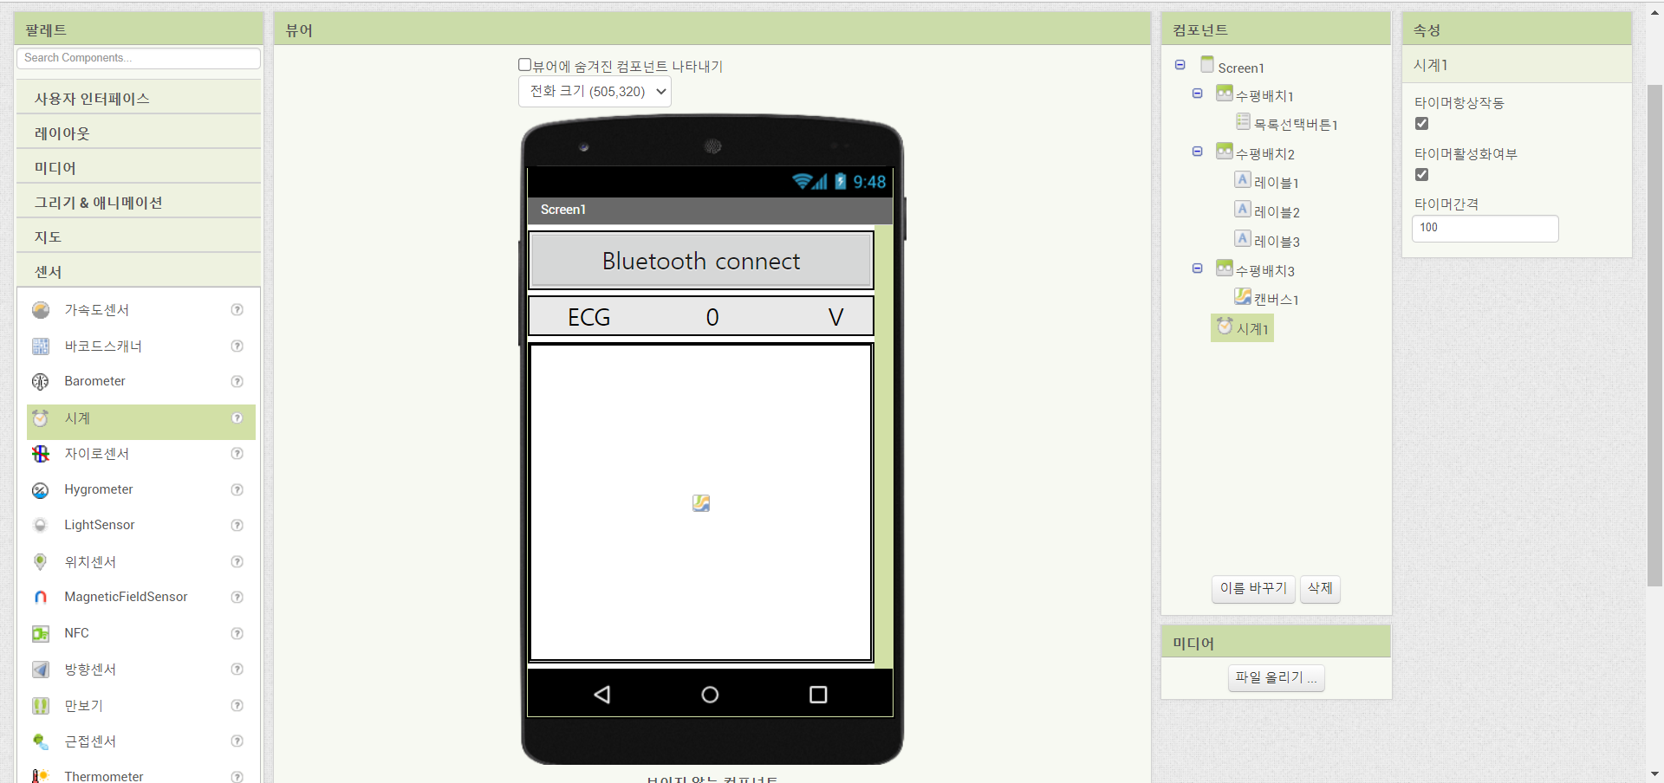
3
MIT APP INVENTOR
insert sensor(clock)
time interval -> 100

Slide 38
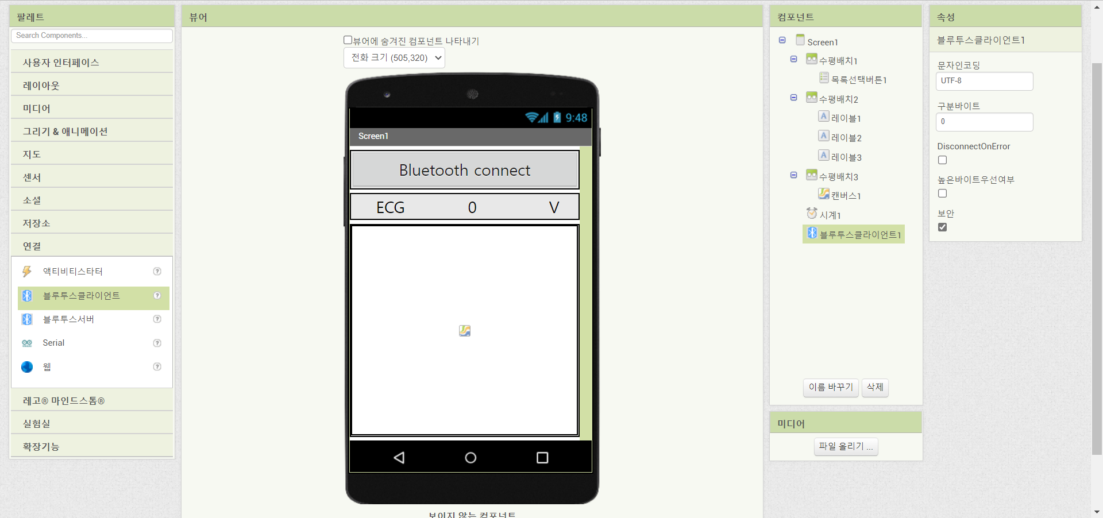
3
MIT APP INVENTOR
connecivity (Bluetooth client) add

Slide 39
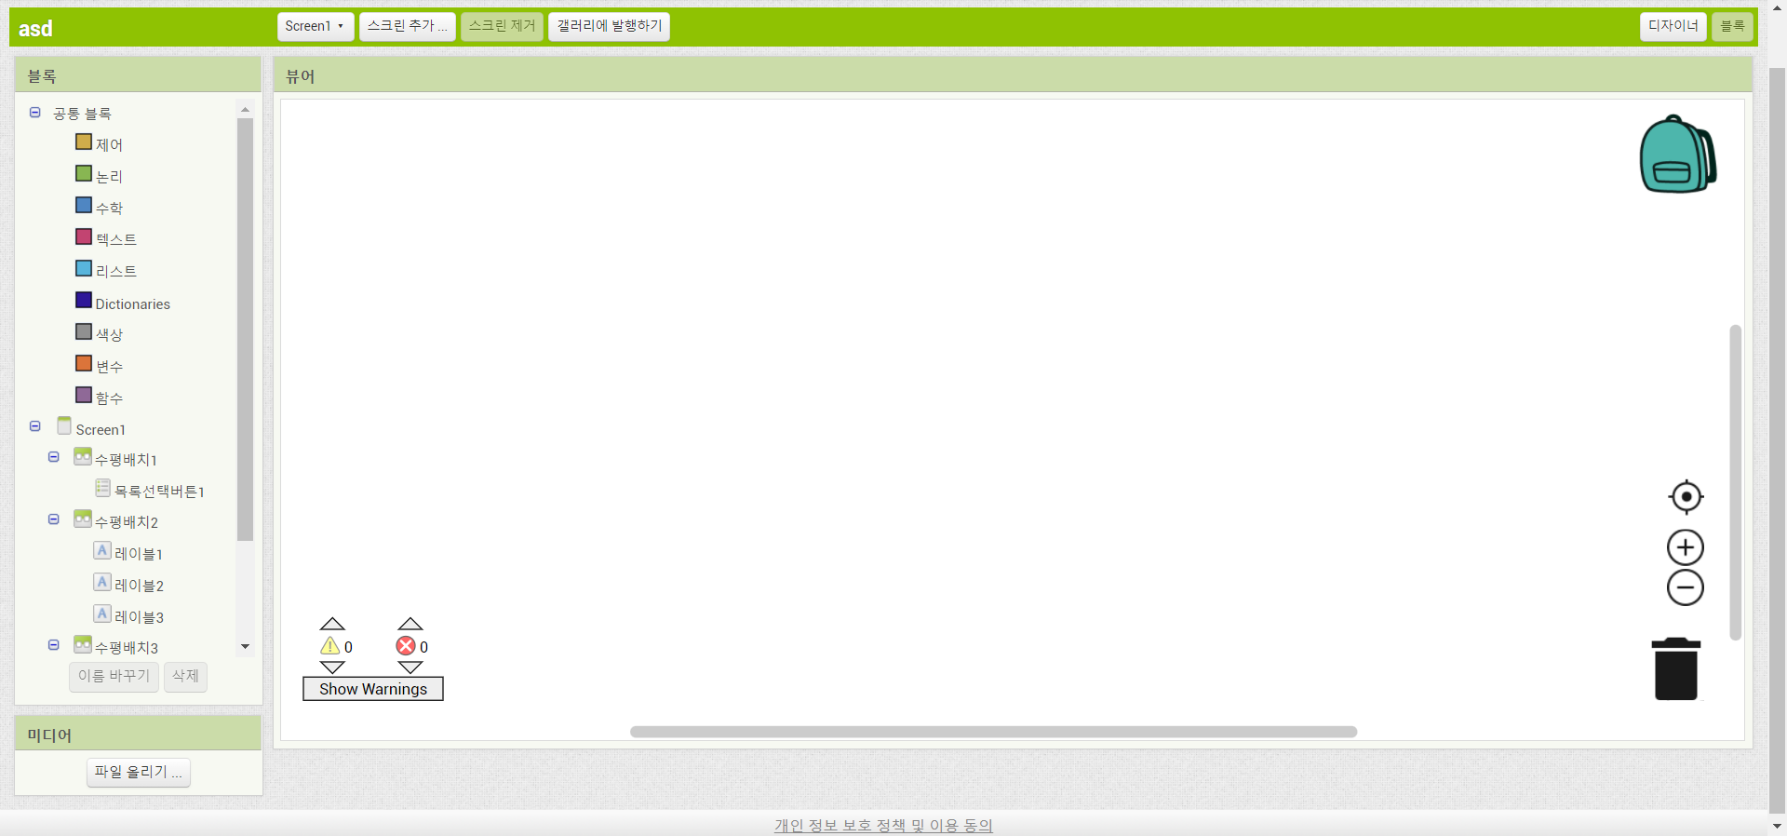
3
MIT APP INVENTOR
select blocks

Slide 40
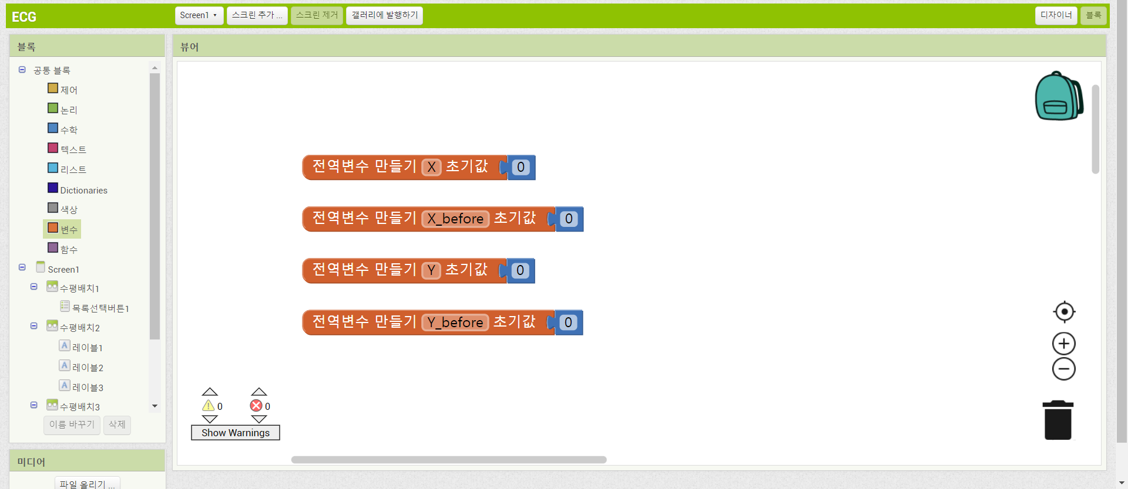
3
MIT APP INVENTOR
bulit-in (variables) -> nitialize global
bulit-in (math) -> 0

Slide 41
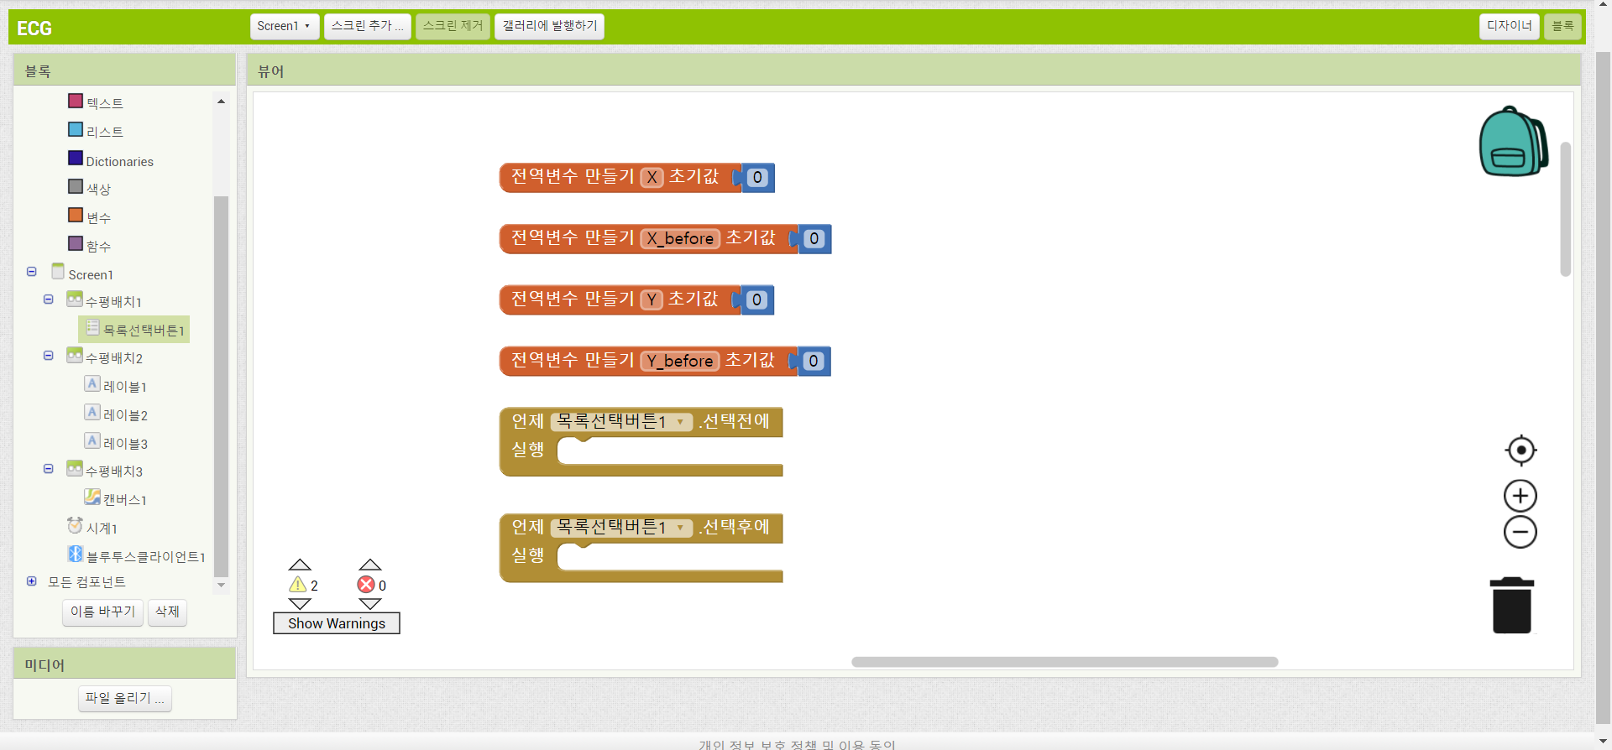
3
MIT APP INVENTOR
list picker 1 -> when list picker 1 beforepicking/afterpicking do

Slide 42
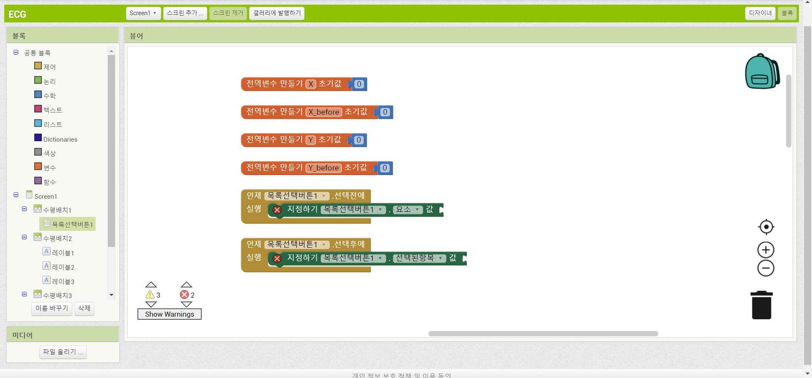
3
MIT APP INVENTOR
list picker 1 -> set list picker 1 elements to/selection to

Slide 43
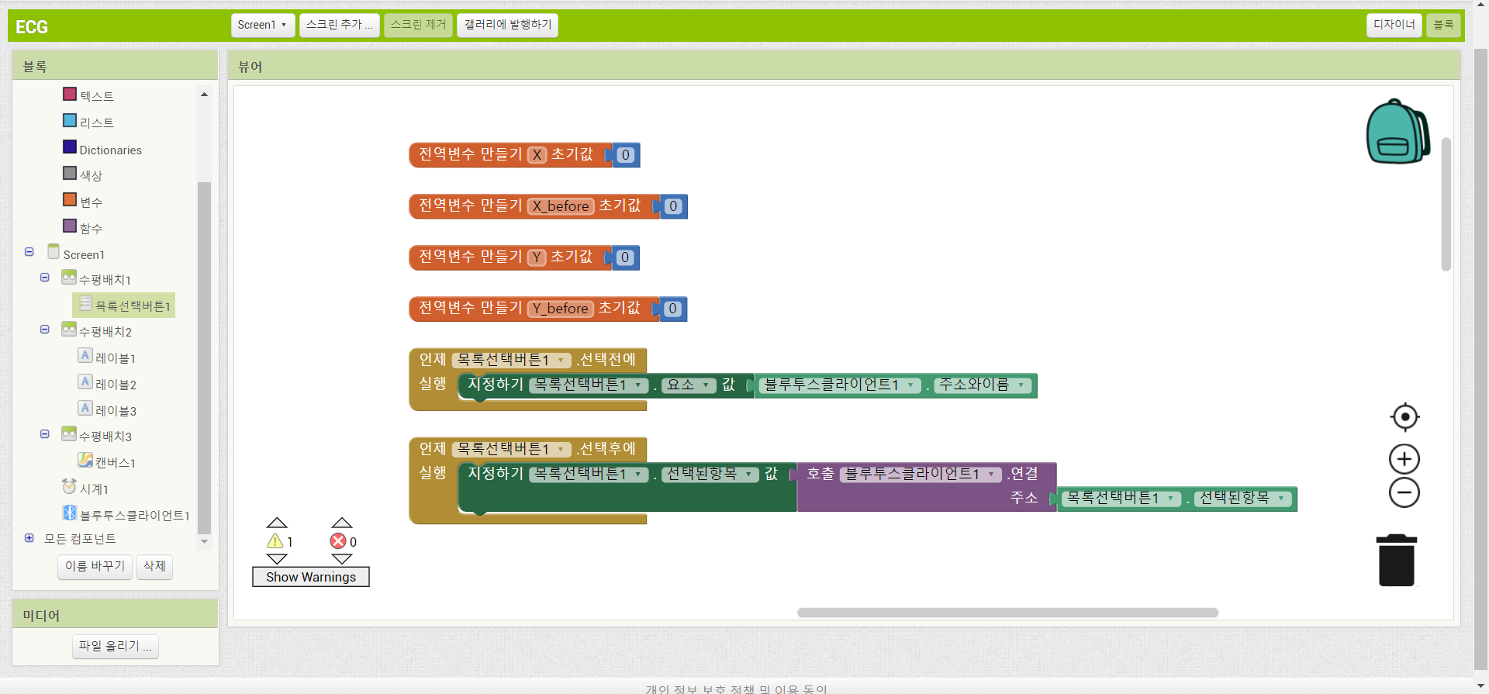
3
MIT APP INVENTOR
bluetooth client 1 -> bluetooth client 1 addresss and names, call bluetooth client1 connect address
list picker 1 -> list picker 1 selection

Slide 44
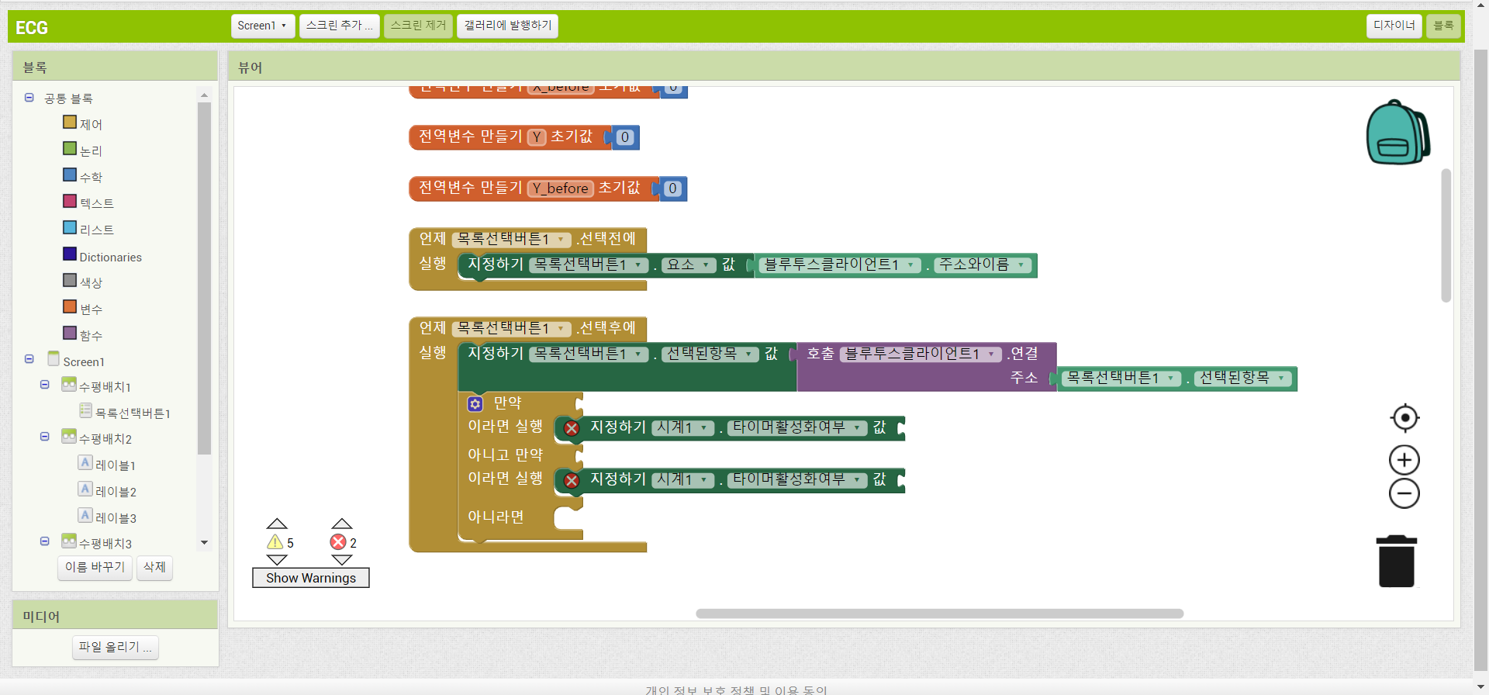
3
MIT APP INVENTOR
control -> if then else if then else
clock 1 -> set clock 1 timer enabled to

Slide 45
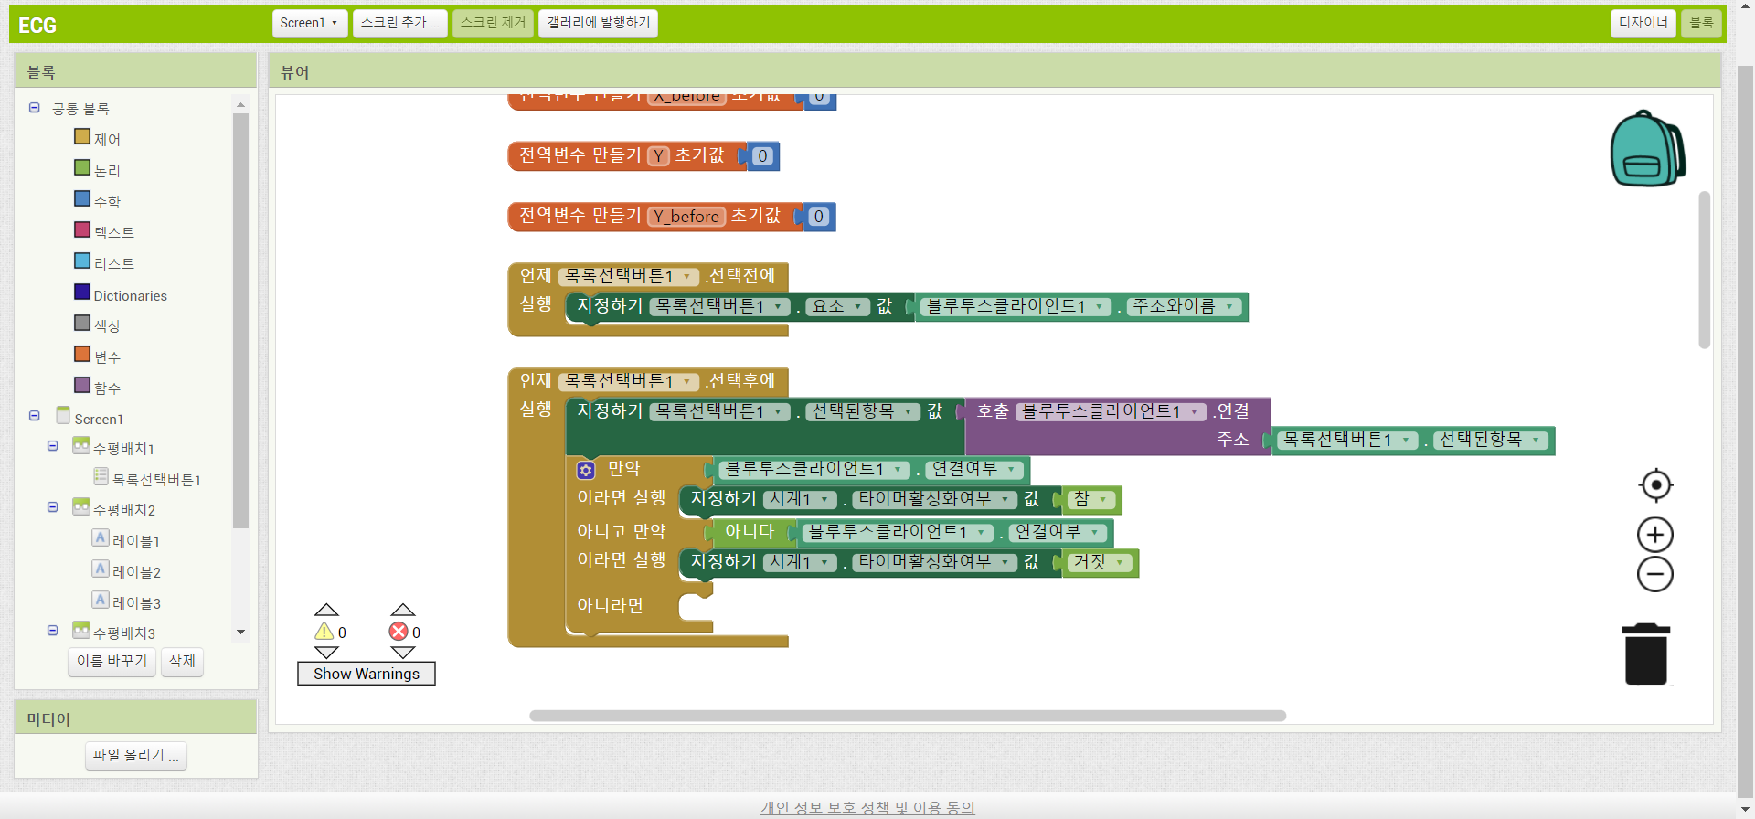
3
MIT APP INVENTOR
bluetooth -> bluetooth client 1 is connected
logic -> true, not, false

Slide 46
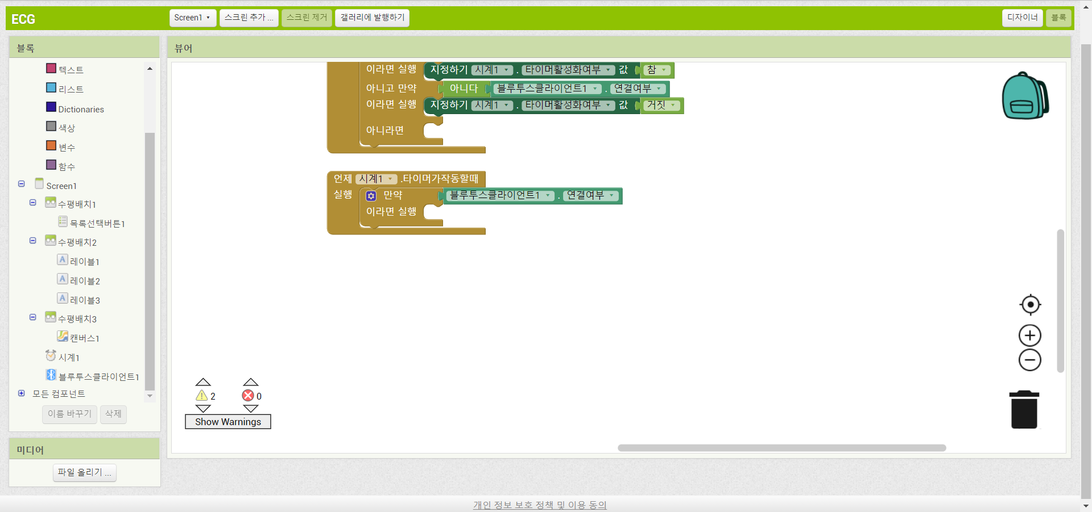
3
MIT APP INVENTOR
clock 1 -> when clock1 timer do
control -> if then
bluetooth 1 -> bluetooth client 1 is connected

Slide 47
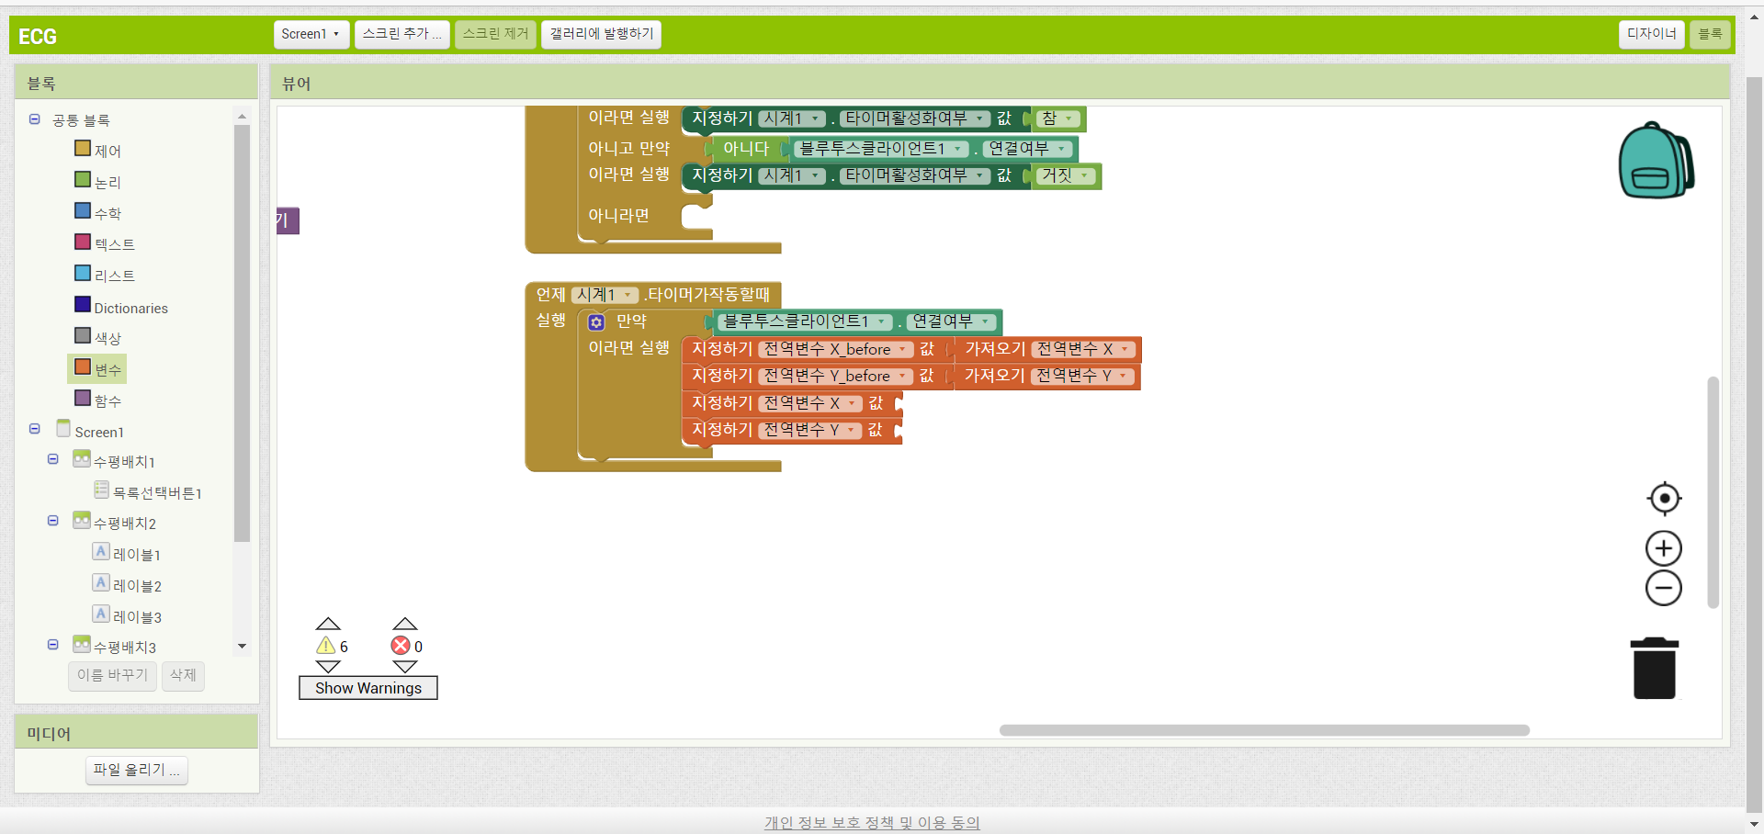
3
MIT APP INVENTOR
variables -> set global X_before to get global X
-> set global Y_before to get global Y
-> set global X to
-> set global Y to

Slide 48
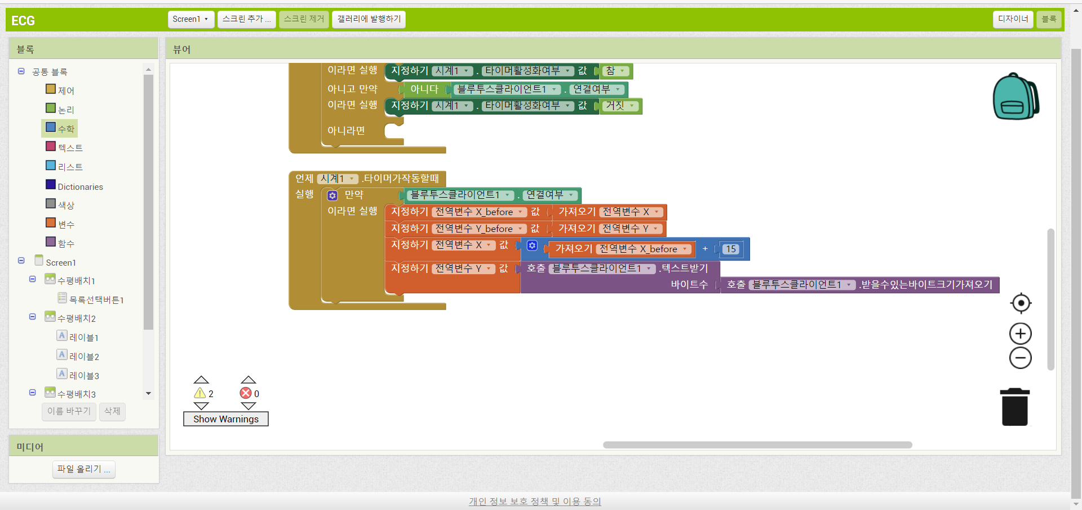
3
MIT APP INVENTOR
math -> □ + □ -> get global X_before-> 15
bluetooth client 1 -> call bluetooth client1 receivetext number of bytes, call bluetooth cluent 1 bytes available to receive

Slide 49
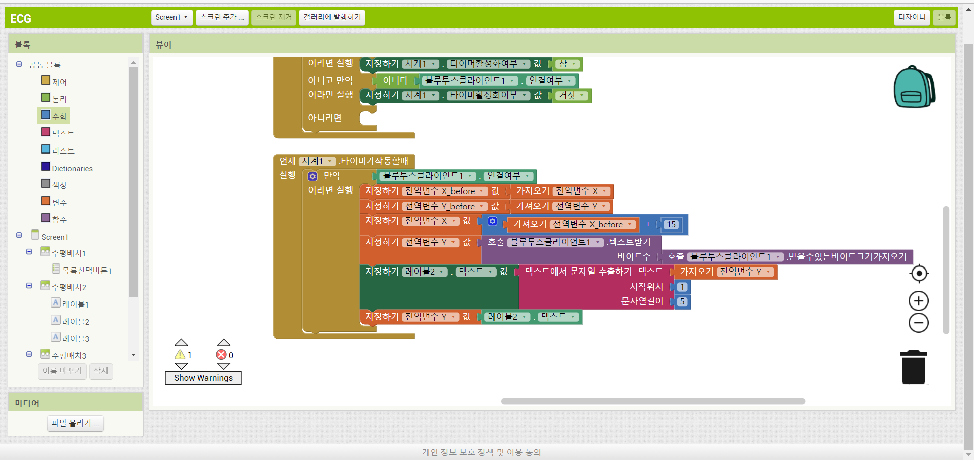
3
MIT APP INVENTOR
label 2 -> set label 2 text to
text -> segment text start length

Slide 50
3
MIT APP INVENTOR
variables -> get global Y
math -> 1, 5

Slide 51
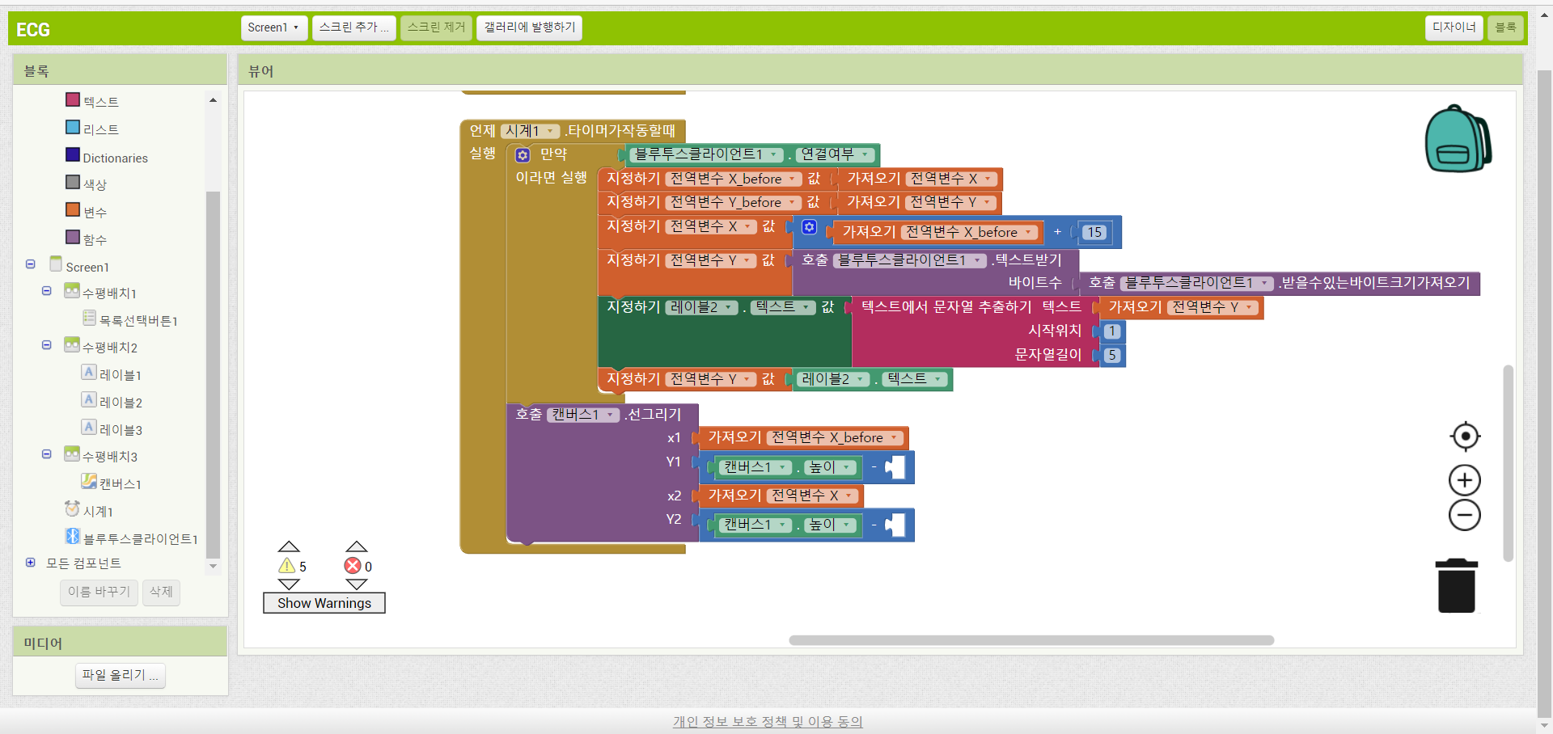
3
MIT APP INVENTOR
canvas 1 -> call canvas1 drawline
variables -> get global Y before, get global X

Slide 52
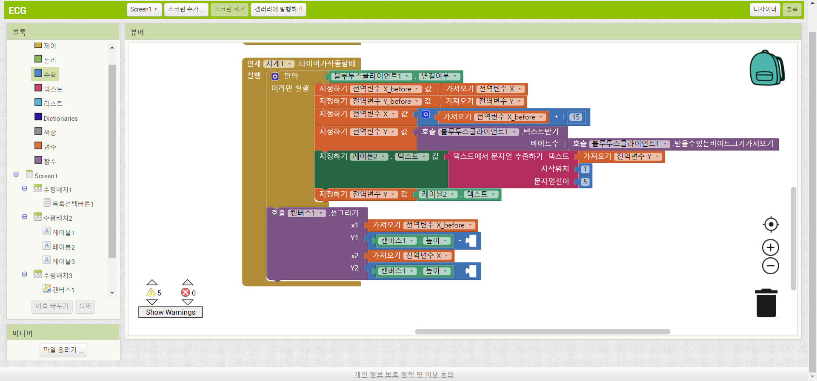
3
MIT APP INVENTOR
math -> □ - □
canvas 1 -> canvas1 height

Slide 53

3
MIT APP INVENTOR
math -> □ X □
math -> 500
variables ->> get global X before, get global Y_before

Slide 54

3
MIT APP INVENTOR
control -> if then
math -> □ = □ -> □ ≥ □

Slide 55

3
MIT APP INVENTOR
variables -> get global X
canvas1 -> canvas1 width

Slide 56
3
MIT APP INVENTOR
canvas1 -> call canvas1 clear
variables -> set global X_before to, get global X to

Slide 57
3
MIT APP INVENTOR
math -> 0

Slide 58

3
MIT APP INVENTOR
build -> Android App

Slide 59

3
MIT APP INVENTOR

Slide 60


3
MIT APP INVENTOR
Google Play Store -> MIT A12 Companion
MIT A12 Companion -> Scan QR code

Slide 61

1
Bluetooth AT command

Slide 62
2
Bluetooth AT command
HC-06 AT commands
To check connection, send ’AT’, and you should get ‘OK’ back.
Send: AT
To check HC-06 version.
Send: AT+VERSION
To check HC-06 address.
Send: AT+ADDR
To set the device name send below command.
Send: AT+NAMEDEVICE01
To set the Bluetooth password.
Send: AT+PSWD1234
To set the baudrate send the below command, where ‘X’ is a number corresponding to the baudrate.
Send: AT+BAUD2
AT+BAUDX | Baudrate
1 | 1200
2 | 2400
3 | 4800
4 | 9600(default)
5 | 19200
6 | 38400
7 | 57600
8 | 115200
9 | 230400
A | 460800
B | 921600
C | 1382400

Slide 63

Thank You Thanks Gratitude - Free image on Pixabay

